Slide 1
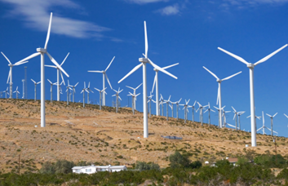
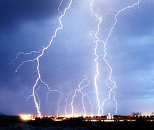
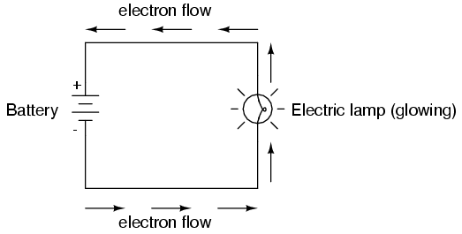
Electricity
How & where it’s used
Review of the atom
Overview of current and static electricity
Types of circuits
Coulombs

Slide 2
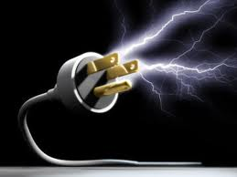
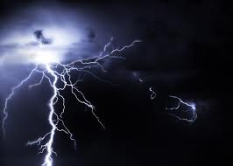
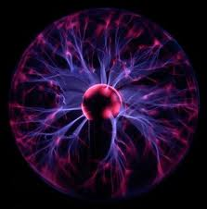
Electricity!
It’s SHOCKING!

Slide 3
Electricity
What is electricity?
Where does it come from?
What do we use it for?
How would your life be different without it?

Slide 4
Bill Nye - Electricity

Slide 5
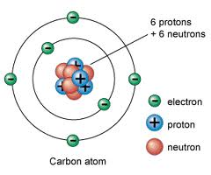
Electricity
Everything in the world is made up of atoms.
Each atom is made of smaller parts. One of those parts is called an electron.
Electrons can move from atom to atom.
When electrons move quickly from one atom to another it is called Electricity!

Slide 6
The Atom
Inside an atom, electrons have a negative charge and protons have a positive charge.

Slide 7
The Atom
An atom is composed of proton(s), electron(s) and neutron(s)
Name | Mass | Charge | Location
Proton | 1 | +1 | In the nucleus
Electron | Negligible | -1 | Outside the nucleus
Neutron | 1 | 0 | In the nucleus

Slide 8
We will be dealing with two types of electricity: Current and Static Electricity
Electricity and Circuits

Slide 9
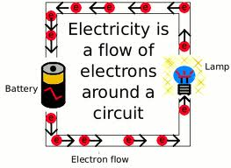
Current Electricity
Type of electricity used in our homes.
The steady flow of electricity is called an electric current.
A current will move along a wire or a path called a circuit.
Circuit means to “go around.”

Slide 10
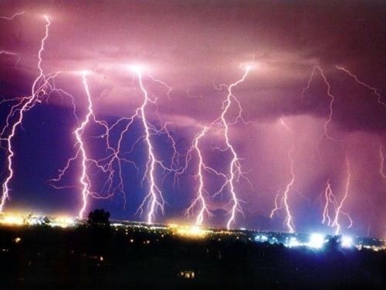
Static Electricity
Static electricity is the charge that stays on an object.
Charges can then jump from one object to another
Static shocks e.g. Lightning

Slide 11
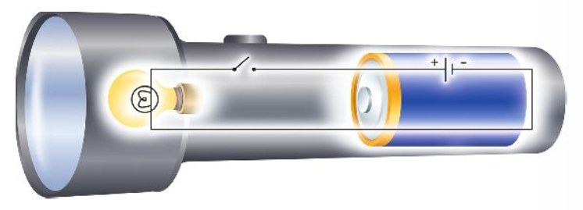
ELECTRICAL CIRCUITS
Current electricity is the flow of electrons through a circuit.

Slide 12
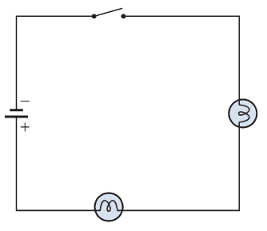
Drawing circuit diagrams
Called “schematic circuit diagrams”
Connecting wires are drawn as straight lines (that means with rulers) and at right angled corners.
Circuit components are symbols which are simple and usually look similar to what is happening

Slide 13
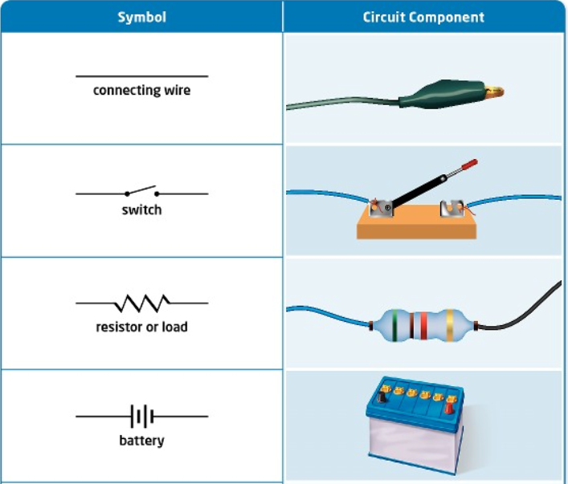
Parts of an Electric Circuit
Example
Copper wire
Light Switch
Toaster
AA battery

Slide 14
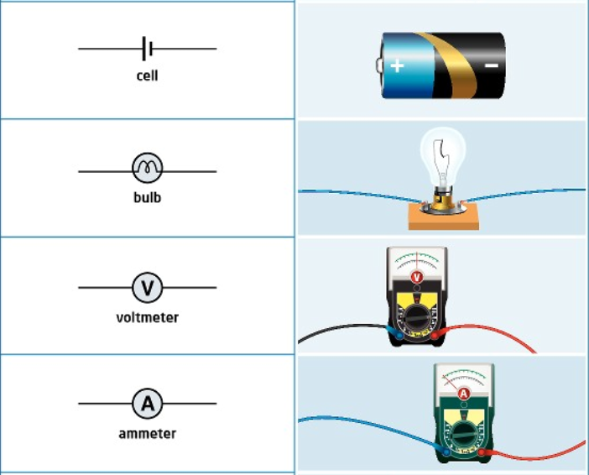
Parts of an Electric Circuit
Example
Two or more = battery
Light Bulb
Voltmeter
Ammeter

Slide 15
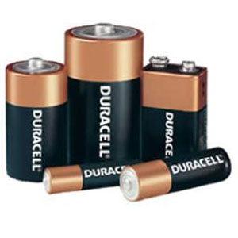
The CELL
The cell stores chemical energy and transfers it to electrical energy when a circuit is connected.
When two or more cells are connected together we call this a Battery.
The cells chemical energy is used up pushing a current round a circuit.

Slide 16
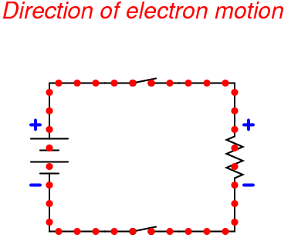
Open vs. Closed Circuits
A circuit can be described as either open or closed
Closed circuit: the circuit is operating and the current is flowing. The light switch is “on” and so are the lights.
Open circuit: The circuit is NOT operating. The light switch is “off” and so are the lights

Slide 17
What is an electric current?
An electric current is a flow of microscopic particles called electrons flowing through wires and components.
-
+
In which direction does the current flow?
Current flows from the Negative terminal to the Positive terminal of a cell.

Slide 18
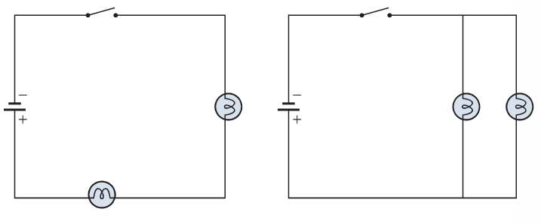
Types of circuits
There are two types of electrical circuits;
SERIES CIRCUITS
PARALLEL CIRCUITS

Slide 19
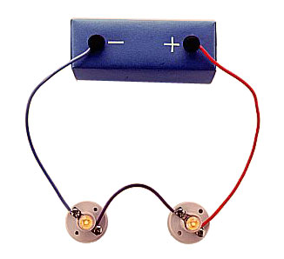
SERIES CIRCUITS
The components are connected end-to-end, one after the other.
They make a simple loop for the current to flow round.
If one bulb ‘blows’ it breaks the whole circuit and all the bulbs go out.

Slide 20
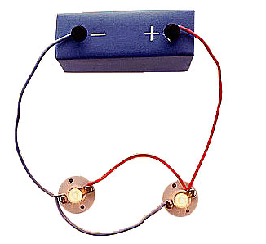
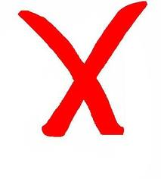
PARALLEL CIRCUITS
The components are connected side by side.
The current has a choice of routes.
If one bulb ‘blows’ there is still a complete circuit so the other bulb will stays alight.

Slide 21
KEY TERM - CURRENT
The flow of electricity around a circuit is called CURRENT and runs from negative to positive
Current (Abbreviated to I, e.g. I = 1) is measured in amps (A) and is the amount of electrons passing a given point in one second

Slide 22
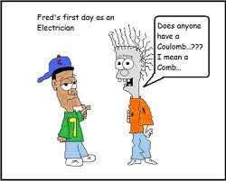
Coulombs (C)
1 Amp is the amount of electrons passing a given point in one second
1 Amp = 1 Coulombs = 6.25x10¹⁸ electrons
Therefore if the current flowing through the wire or toaster or hair dryer is 1 amp, that means that 6.25X10¹⁸ electrons flowed past that point every second

Slide 23
Coulomb Questions
How many electrons pass a point every second if the current is 2 A?
How many electrons pass a point every second if the current is 12.6 A?
What is the current if 3.125x10¹⁸ electrons pass a point every second?

Slide 24
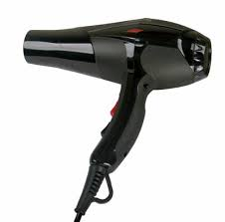
For Homework
Find 3 things in your house that list the current they use. Write these figures down (name and current used) and bring to class tomorrow.
Current might be listed on power cords

